Slide 1
HEART DISEASE UCI
Link- https://www.kaggle.com/ronitf/heart-disease-uci
Data- heart

Slide 2
CHALLENGES IN THE PROJECT
No challenges faced.

Slide 3
MAJOR FINDINGS THROUGH EDA
Fixing outliers.

Slide 4
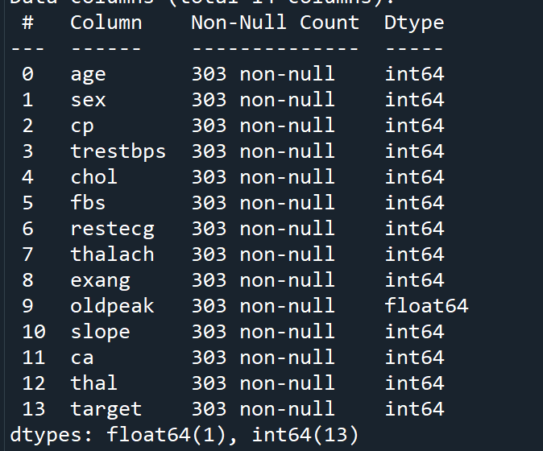
BINARY CLASSIFICATION
Shape-
(303, 14)

Slide 5
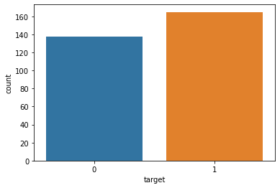
Target Variable- target
Categorical variable
No null values

Slide 6
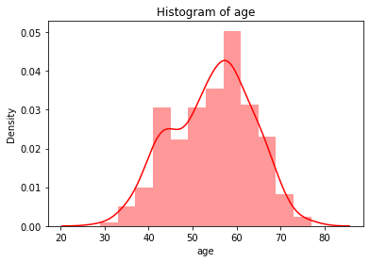
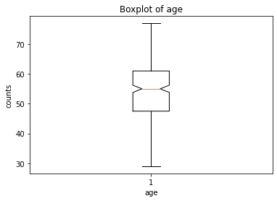
1st variable- age
Continuous variable There are no outliers.
No null values

Slide 7
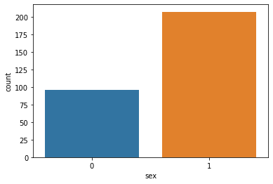
2nd variable- sex
Categorical variable
No null values
1- Male and 0- Female

Slide 8
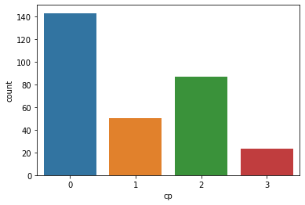
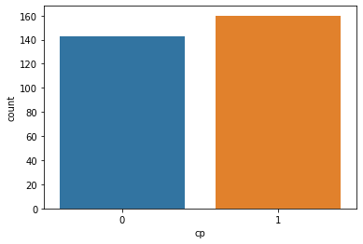
3rd variable- cp
Categorical variable After merging
No null values

Slide 9
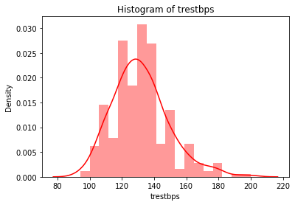
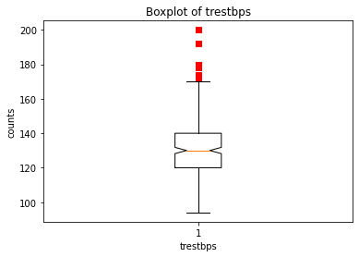
4th variable- trestbps
Continuous variable There are outliers.
No null values

Slide 10
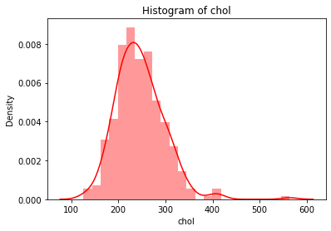
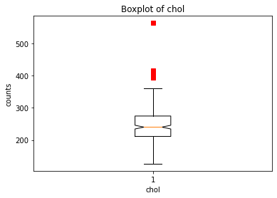
5th variable- chol
Continuous variable There are outliers.
No null values

Slide 11
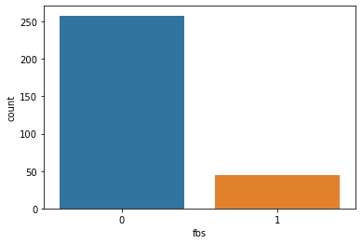
6th variable- fbs
Categorical variable
No null values
0- No, 1-Yes

Slide 12
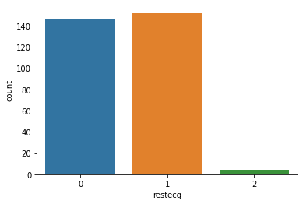
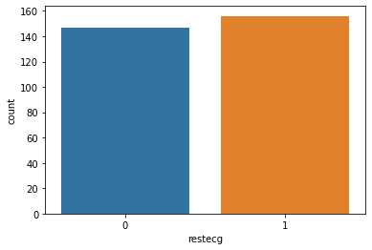
7th variable- restecg
Categorical variable After merging
No null values

Slide 13
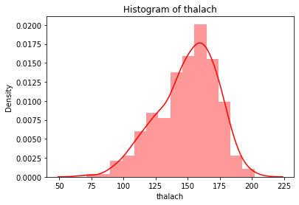
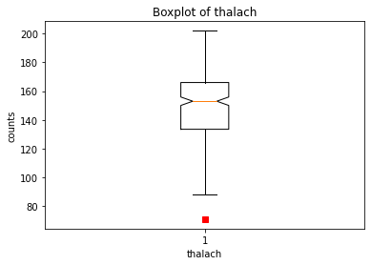
8th variable- thalach
Continuous variable There are outliers.
No null values

Slide 14
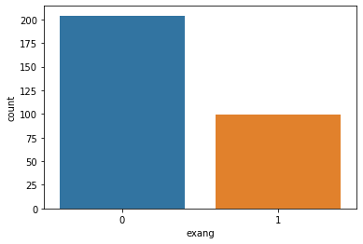
9th variable- exang
Categorical variable
No null values

Slide 15
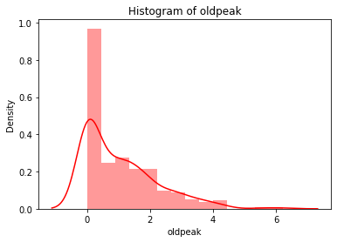
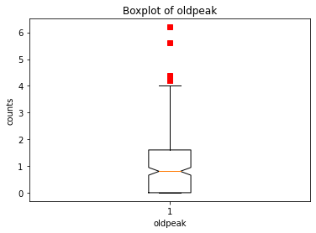
10th variable- oldpeak
Continuous variable There are outliers.
No null values

Slide 16
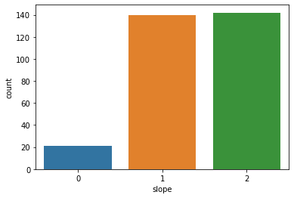
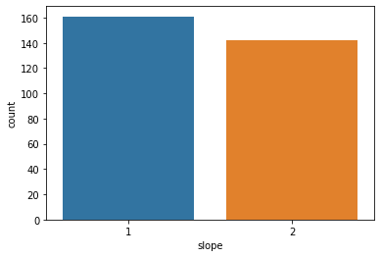
11th variable-
Categorical variable After merging
No null values

Slide 17
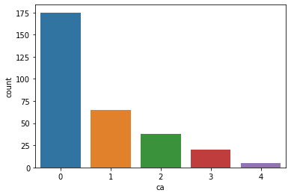
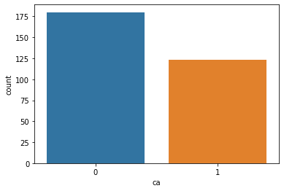
12th variable- ca
Categorical variable After merging
No null values

Slide 18
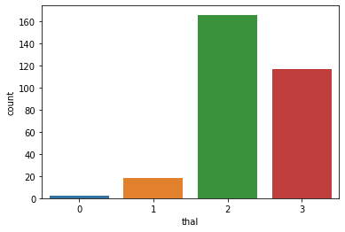
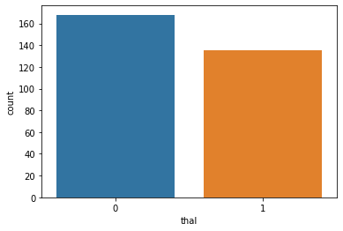
13th variable- thal
Categorical variable After merging
No null values

Slide 19
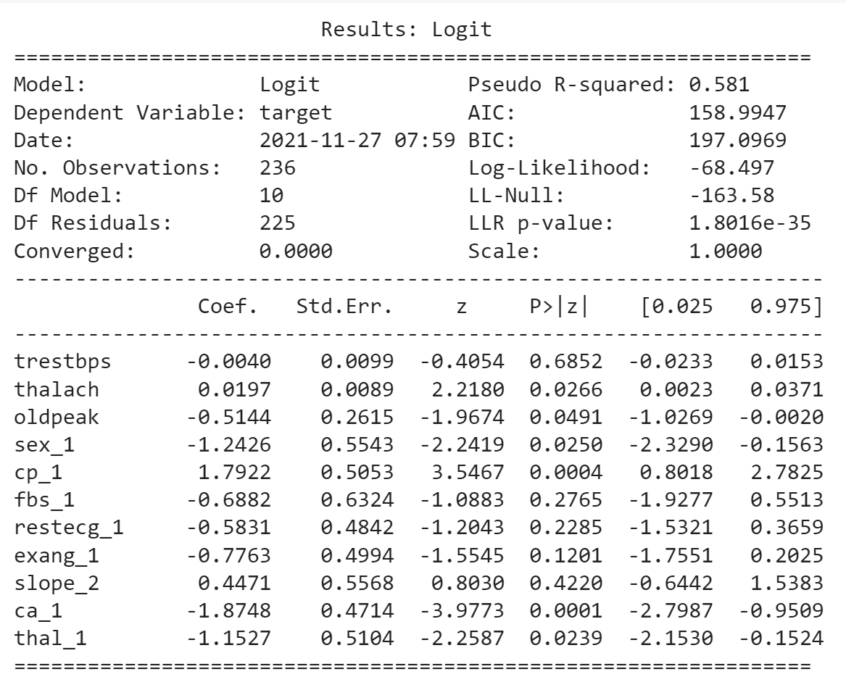
LOGISTIC MODEL BY STATISTIC APPROACH
Recursive Feature Elimination-11

Slide 20
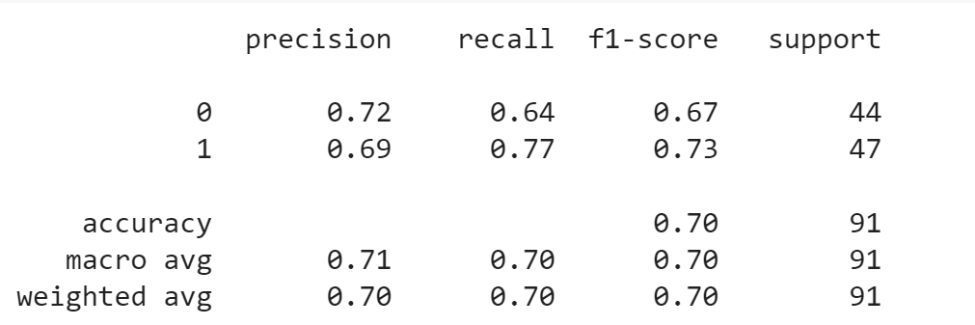
LOGISTIC MODEL BY SK LEARN APPROACH

Slide 21
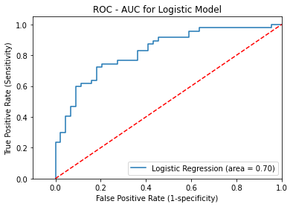

Slide 22
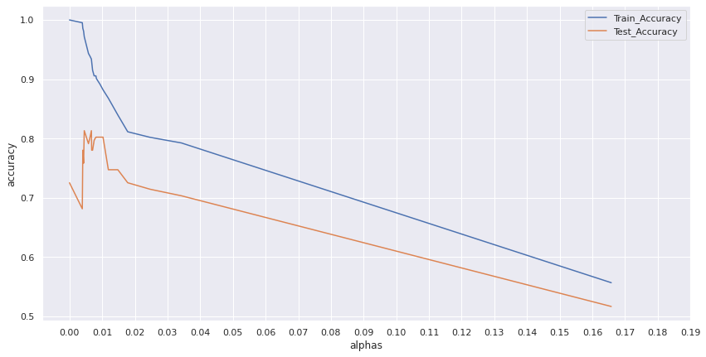
DECISION TREE MODEL
Ccp alpha-0.015

Slide 23
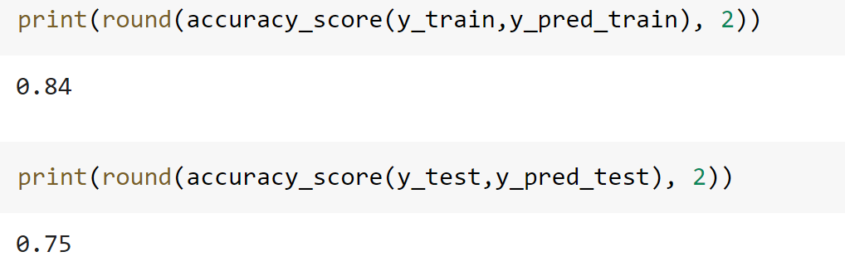

Slide 24
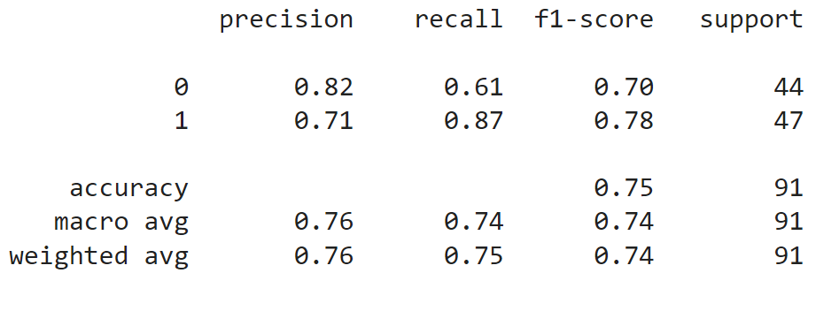

Slide 25
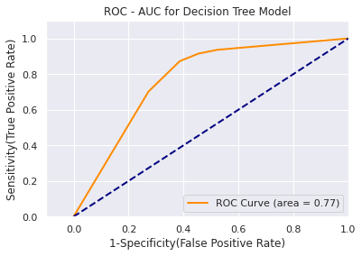

Slide 26
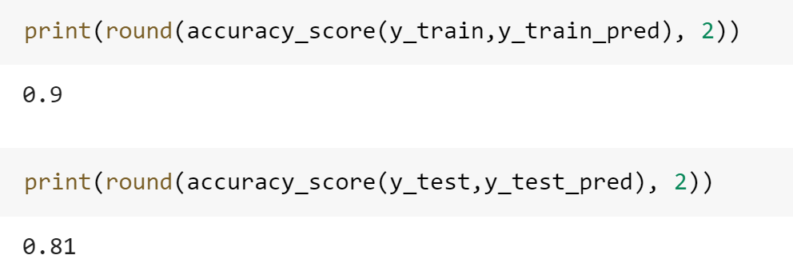
RANDOM FOREST MODEL

Slide 27
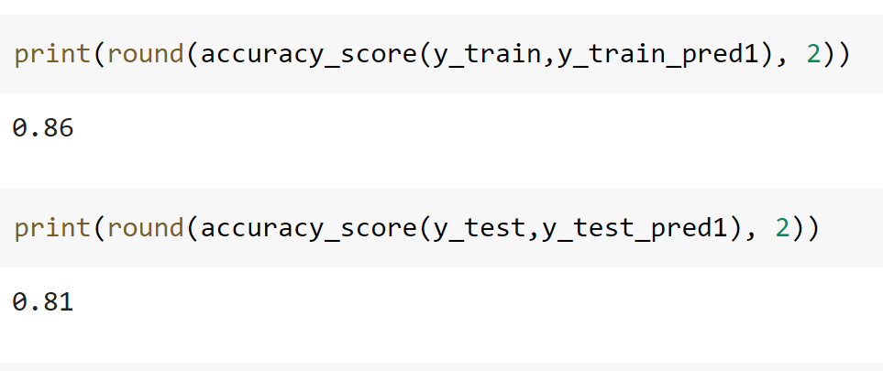
Extract Feature Importance- 5

Slide 28
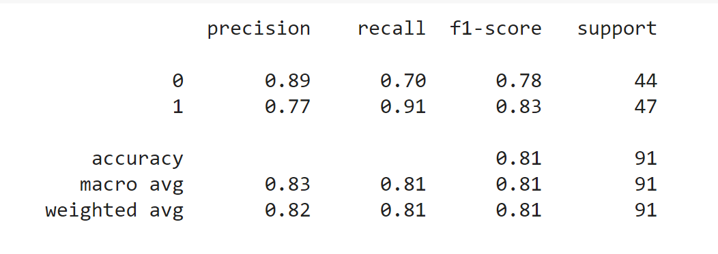

Slide 29
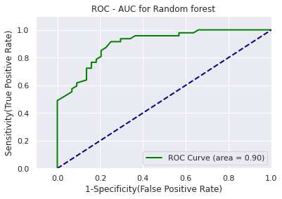

Slide 30
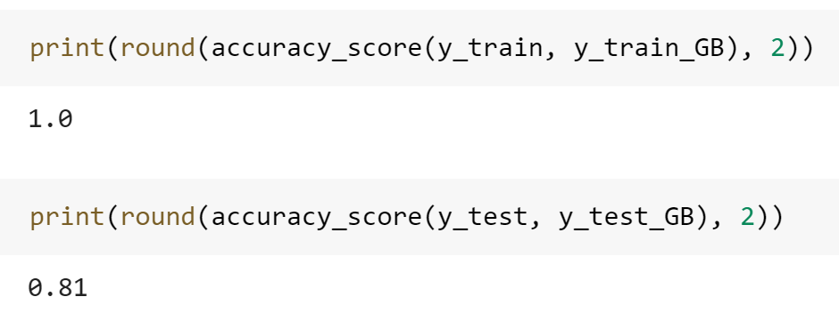
GRADIENT BOOSTING MODEL

Slide 31
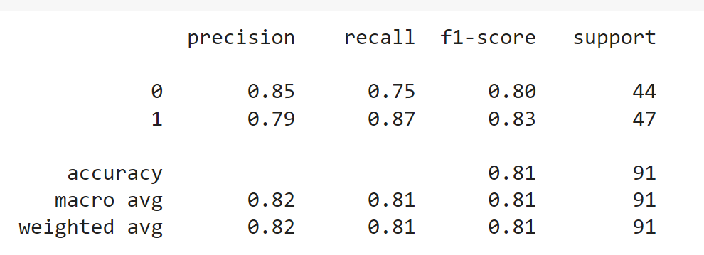

Slide 32
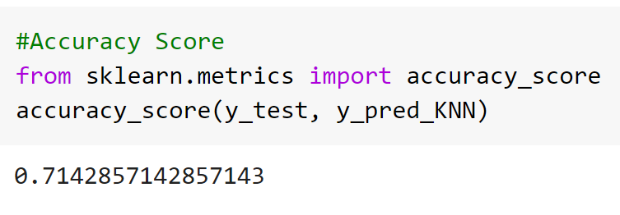
KNOWING YOUR NEAREST NEIGHBOURS(KNN) MODEL
N_neighbours- 9

Slide 33
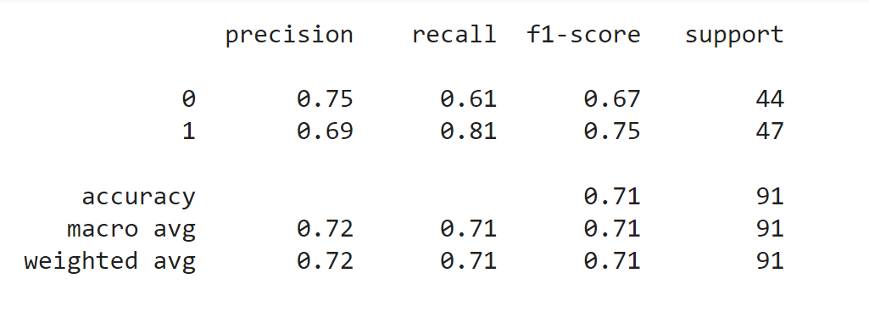

Slide 34
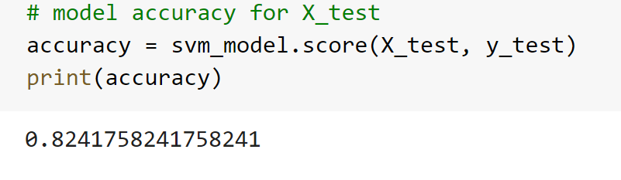
SUPPORT VECTOR MACHINE (SVM) MODEL

Slide 35
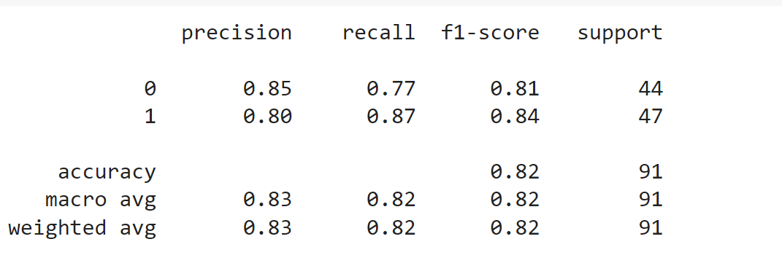

Slide 36
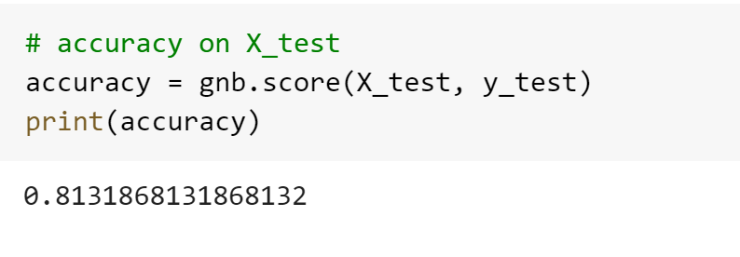
NAIVE BAYES MODEL

Slide 37
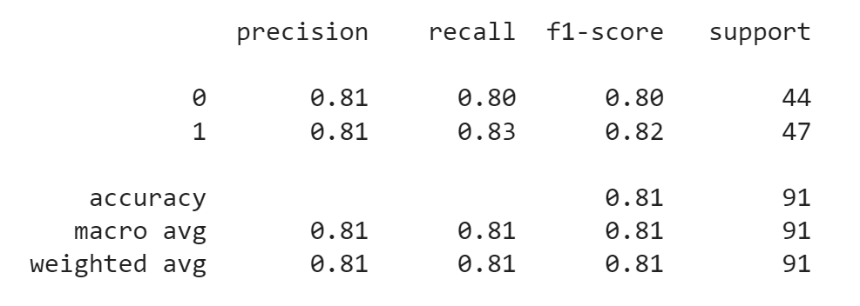

Slide 38
By comparing all the accuracies we can say that the best model is Random Forest model with the accuracy of 0.81.

Slide 39
THANK YOU

